Slide 1
For a device such as an amplifier or telecommunications system, group delay and phase delay are device performance properties that help to characterize time delay, which is the amount of time for the various frequency components of a signal to pass through the device from input to output. If this timing does not sufficiently meet certain requirements, the device will contribute to signal distortion. Phase delay gives the time delay of the various frequency components of a signal. For a modulated signal, which must be demodulated to recover the original signal intelligence, group delay must be used with the modulated signal to determine the time delay of the demodulated signal.
Phase Delay and Group Delay

Slide 3
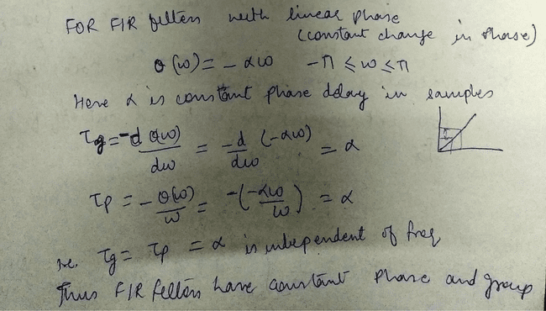

Slide 4
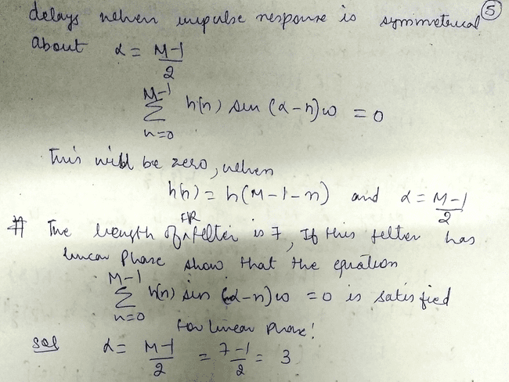

Slide 5
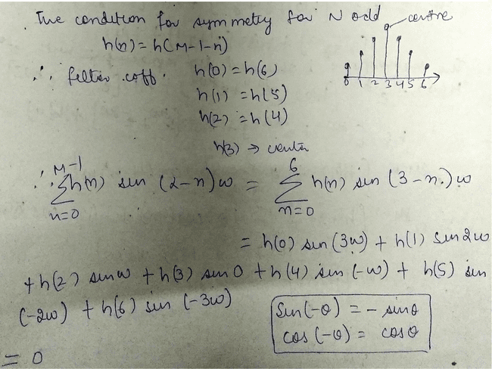

Slide 6
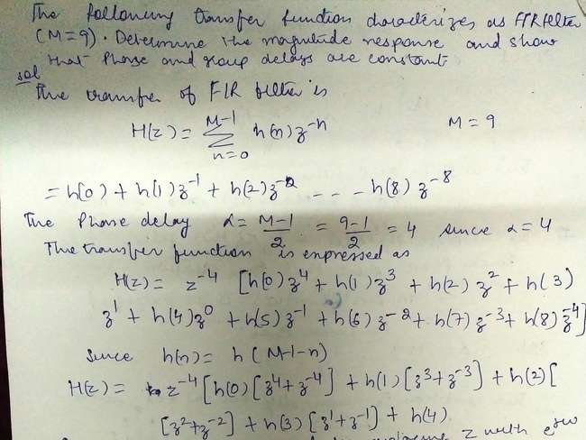

Slide 7
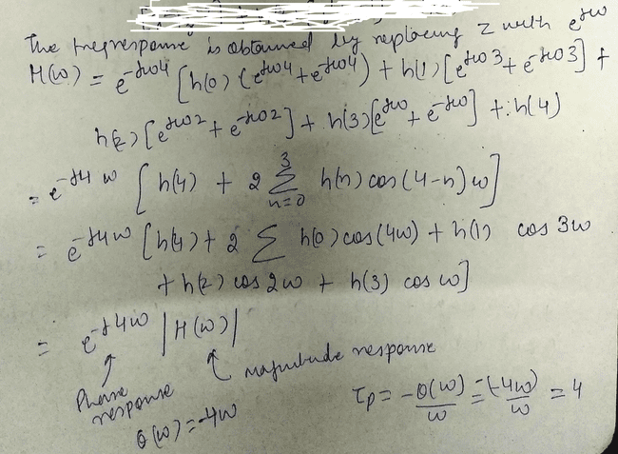

Slide 8
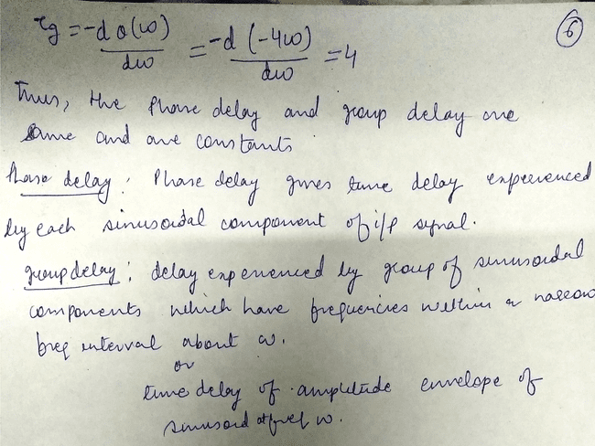

Slide 9
clc
clear all
close all
% multiple plots
x = 0:pi/100:2*pi;
y1 = 2*cos(x);
y2 = cos(x);
y3 = 0.5*cos(x);
plot(x,y1,'--',x,y2,'b',x,y3,'r')
xlabel('number of samples')
ylabel('Cosine functions')
legend('2*cos(x)','cos(x)','0.5*cos(x)')
title('Example of multiple plots')
axis([0 2*pi -3 3])

